Slide 1


MUSIC GENRE CLASSIFICATION
Salil Vinit Kulkarni
Sneha Konoth
Vivek Kumar
Priyanka Arumugam
LSTM MODEL
GTZAN dataset is used here for music genre classification.
There are 10 different genres in the dataset having 100 audio tracks per genre, summing up to 1000 music files.
Genres available are Blues, Classical, Country, Disco, HipHop, Jazz, Metal, – Popular- Reggae-Rock
Main Features- - FFT -Spectrogram- MFCCs
A sequential model with a linear stack of layers is used.
First layer is the LSTM layer with 64 units and it returns sequences to the next LSTM layer.
We have a dense layer with ‘relu’ activation followed by a dropout layer to avoid overfitting.
Atlast, we have a fully connected dense layer with ‘softmax’ activation and final neurons equal to the ten different genres. The model fit over 100 epochs with batch size of 32.
The accuracy of the predicted test dataset from the model is 80%.
Output
Output
Softmax
Softmax
Dense
q
q
q
q
q
q
LSTM 2
LSTM 2
LSTM 1
LSTM 1
Input Layer
Input Layer

Slide 2
GENETIC ALGORITHM +SVM MODEL
Genetic Algorithm is the feature extraction technique which is motivated by the human genetic process of passing genes over generations.
While implementing GA for feature extraction, we are mainly using five recurring functions till we find the optimized number of features.
1.Initial population.
2.Fitness function
3.Selection
4.Cross-over
5.Mutation.
Using genetic algorithm, we extracted 30 useful features out of 57 features available in the audio file.
Later , we are using SVM classifier to train the model for classification, in which we attain a decent accuracy of 84%.
Start
Randomly generating a group of parameters of SVM model
Calculating Fitness function values by using SVM method
Finding out the optimal fitness value
Are optimization criteria met?
No
Generating new group by evolutionary operation
Yes
The parameters corresponding to the optimal fitness value are the parameters to be selected
Stop

Slide 3
XGBOOST CLASSIFIER
1
Parallelized tree building
XGBoost is an optimized version of Gradient Boosting algorithm that shows improved scalability, accuracy, computational speed and overall model performance.
The dataset is subjected to data preprocessing.
The importance of a feature is determined based on the Permutation Importance.
The top 30 features are used to train a XGBoost classifier model.
For hyperparameter tuning, we choose an initial learning rate and determine the optimum number of trees.
The accuracy obtained for XGBoost is 88.4%.
Tree pruning using depth-first approach
2
3
Cache awareness and out-of-core computing
Regularization for avoiding overfitting
4
5
Efficient handling of missing data
In-built cross-validation
capability
6

Slide 4
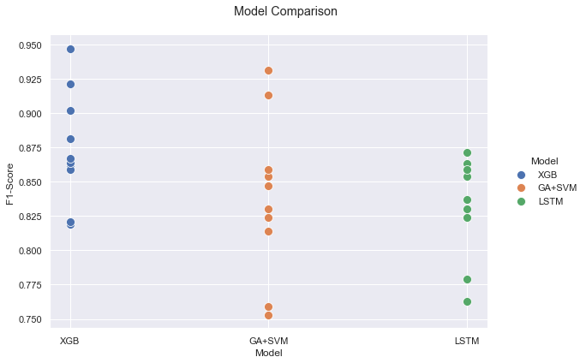
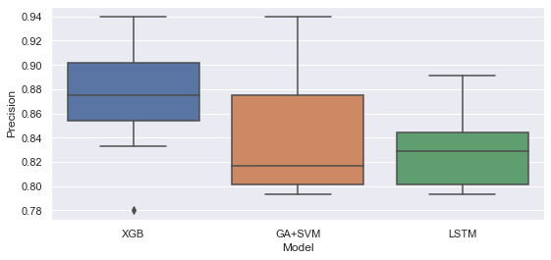
COMPARATIVE ANALYSIS
Box-plot of Precision for the three models
GA+SVM
Sl. No | Approach | Execution Time | Accuracy
1 | LSTM | 4 minutes | 80%
2 | GA + SVM | 12 minutes | 84%
3 | XGBoost | <1 minute | 88.4%
88
XGBOOST model turns out to be best out of three!!!!!!
80
84
LSTM- RNN
XGBoost

